Slide 1

Computer Networks
Application Layer – The Email
Lecture # 04

Slide 2
Network Applications
Some important network applications are:
The Web – HTTP
file transfer - FTP
electronic mail – SMTP, POP
directory service - DNS
P2P applications – Distributed file sharing and lookup service

Slide 3
Application Layer- Services & Ports
DNS (Domain Name System)
Resolves Internet names (URLs) to IP Addresses, port 53
Telnet, SSH (Terminal emulation, Secure shell)
access to servers and network devices, port 23, 22
SMTP (Simple Mail Transfer Protocol)
Transfer of mail messages and attachments (outgoing), port 25
POP3, POP3S (Post Office Protocol)
Transfer of mail messages and attachments (incoming), port 110, 995
IMAP
Internet Message Access Protocol, port 143
DHCP (Dynamic Host Configuration Protocol)
Assigns IP Addresses (IP, subnetmask) and other parameters (DNS, Gateway, …) to hosts, port 67, 68
HTTP(s) (Hypertext Transfer Protocol)
Transfer files that make up web pages, port 80, 443
FTP(S) ((Secure) File Transfer Protocol)
Interactive file transfer between systems, port control:21,data:21 and 3713, data:989,990

Slide 4
The Domain Name System
The Internet’s Directory Service.
Hostname to IP Address.
IPv4, IPv6
The DNS is specified in RFC 1034 and RFC 1035, and updated in several additional RFCs.
A Complex system

Slide 5
Services Provided by DNS
The DNS is
(1) a distributed database implemented in a hierarchy of DNS servers, and
(2) an application-layer protocol that allows hosts to query the distributed database.
The DNS servers are often UNIX machines running the Berkeley Internet Name Domain (BIND) software [BIND 2012].
The DNS protocol runs over UDP
Port 53.
DNS is commonly employed by other application-layer protocols—including HTTP, SMTP, and FTP—to translate user-supplied hostnames to IP addresses.

Slide 6
DNS With HTTP
The same user machine runs the client side of the DNS application.
The browser extracts the hostname, www.someschool.edu, from the URL and passes the hostname to the client side of the DNS application.
The DNS client sends a query containing the hostname to a DNS server.
The DNS client eventually receives a reply, which includes the IP address for the hostname.
Once the browser receives the IP address from DNS, it can initiate a TCP connection to the HTTP server process located at port 80 at that IP address.

Slide 7
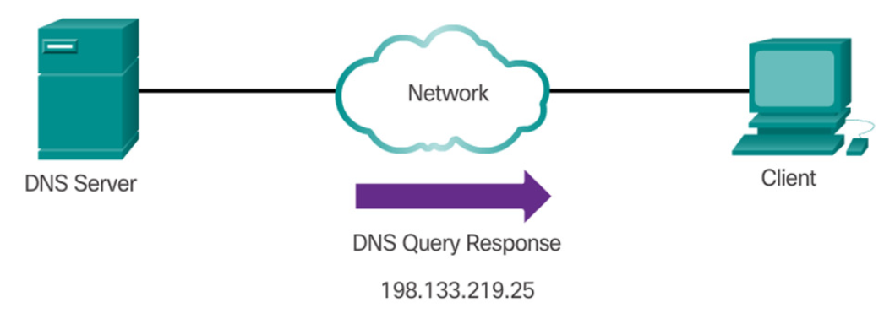
Notes:
Additional delay due to dns
the
desired IP address is often cached in a “nearby” DNS server, which helps to reduce
DNS network traffic as well as the average DNS delay.

Slide 8
Host Aliasing
A host with a complicated hostname can have one or more alias names.
For example, a hostname such as mail.google.com could have, say, two aliases such as gmail.com. In this case, the hostname mail.google.com is said to be a canonical hostname.
Alias hostnames, when present, are typically more mnemonic than canonical hostnames.

Slide 9
Mail Server Aliasing
MX records
Canonical names is hard to use in emails.
Same names for Web and Mail Server of a company
Notes:
For obvious reasons, it is highly desirable that e-mail
addresses be mnemonic. For example, if Bob has an account with Hotmail, Bob’s
e-mail address might be as simple as bob@hotmail.com. However, the hostname
of the Hotmail mail server is more complicated and much less mnemonic
than simply hotmail.com (for example, the canonical hostname might be
something like relay1.west-coast.hotmail.com). DNS can be
invoked by a mail application to obtain the canonical hostname for a supplied
alias hostname as well as the IP address of the host. In fact, the MX record (see
below) permits a company’s mail server and Web server to have identical
(aliased) hostnames; for example, a company’s Web server and mail server can
both be called enterprise.com.

Slide 10
Load Balancing
Same site, multiple servers.
For replicated Web servers, a set of IP addresses is thus associated with one canonical hostname.
The DNS database contains this set of IP addresses.
When clients make a DNS query for a name mapped to a set of addresses, the server responds with the entire set of IP addresses but rotates the ordering of the addresses within each reply.
A client typically sends its HTTP request message to the IP address that is listed first in the set, DNS rotation distributes the traffic among the replicated servers.

Slide 11
Centralized DNS Issues
Single point of failure
Traffic Volume
Distant centralized Databases causing Delays
Maintenance
In summary, a centralized database in a single DNS server simply doesn’t scale. Consequently, the DNS is distributed by design. In fact, the DNS is a wonderful example of how a distributed database can be implemented in the Internet.

Slide 12
Distributed DNS
Distributed
Hierarchical Database
Three Classes of DNS Servers
Root DNS Servers Top Level Domain TLD DNS Servers
Authoritative DNS Servers

Slide 13
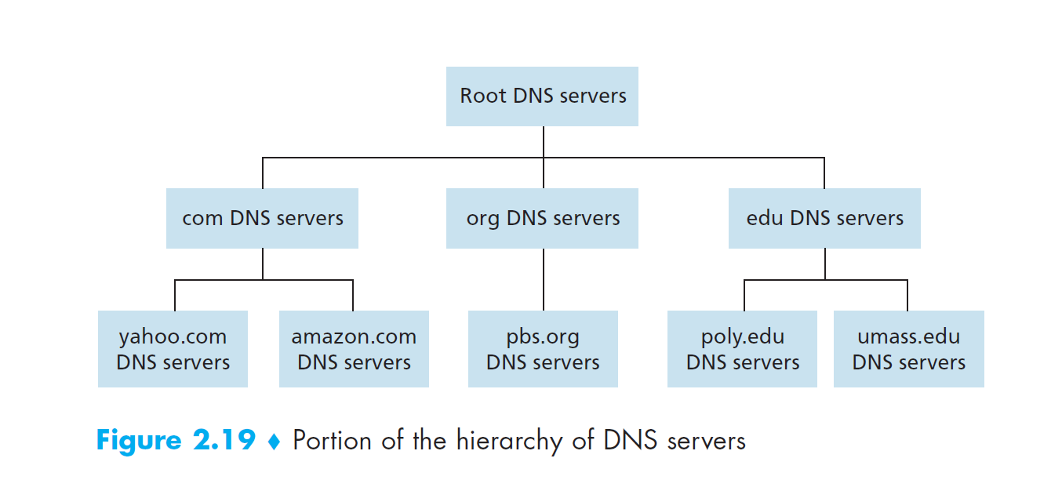

Slide 14
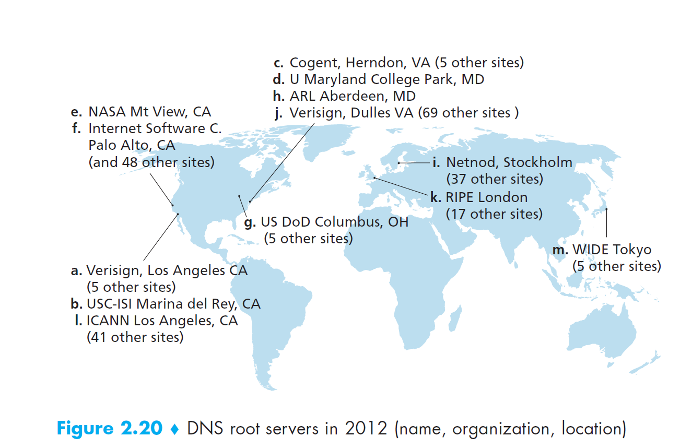
Root DNS Servers
13 Servers
Notes:
each “server” is actually
a network of replicated servers, for both security and reliability purposes. All
together, there are 247 root servers as of fall 2011.

Slide 15
Top Level Domain TLD DNS Servers
These servers are responsible for top-level domains such as com, org, net, edu, and gov, and all of the country top-level domains such as uk, fr, ca, and jp.
The company Verisign Global Registry Services maintains the TLD servers for the com top-level domain, and the company Educause maintains the TLD servers for the edu top-level domain.
See [IANA TLD 2012] for a list of all top-level domains.

Slide 16
Authoritative Name Servers
Every organization with publicly accessible hosts (such as Web servers and mail servers) on the Internet must provide publicly accessible DNS records that map the names of those hosts to IP addresses.
An organization’s authoritative DNS server houses these DNS records.
An organization can choose to implement its own authoritative DNS server to hold these records
The organization can pay to have these records stored in an authoritative DNS server of some service provider.
Most universities and large companies implement and maintain their own primary and secondary (backup) authoritative DNS server.

Slide 17
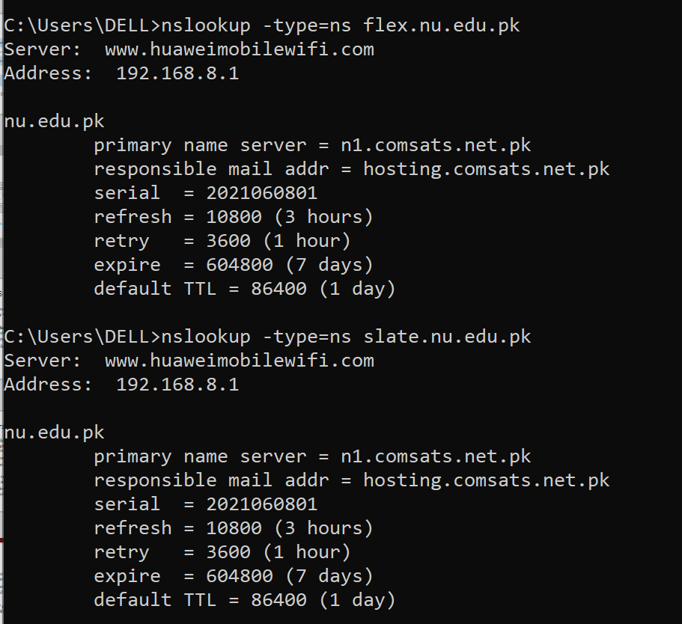

Slide 18
Local DNS Server
A local DNS server does not strictly belong to the hierarchy of servers but is nevertheless central to the DNS architecture.
Each ISP—such as a university, an academic department, an employee’s company, or a residential ISP—has a local DNS server (also called a default name server).
When a host connects to an ISP, the ISP provides the host with the IP addresses of one or more of its local DNS servers

Slide 19
Types of DNS
Recursive DNS
Iterative DNS

Slide 20
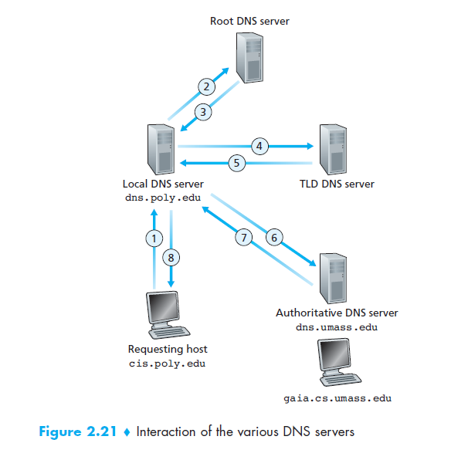
Notes:
For example, suppose again that the University of Massachusetts has a DNS server for the university, called dns.umass.edu. Also
suppose that each of the departments at the University of Massachusetts has its own
DNS server, and that each departmental DNS server is authoritative for all hosts in
the department. In this case, when the intermediate DNS server, dns.umass.edu,
receives a query for a host with a hostname ending with cs.umass.edu, it returns
to dns.poly.edu the IP address of dns.cs.umass.edu, which is authoritative
for all hostnames ending with cs.umass.edu. The local DNS server
dns.poly.edu then sends the query to the authoritative DNS server, which
returns the desired mapping to the local DNS server, which in turn returns the mapping
to the requesting host. In this case, a total of 10 DNS messages are sent!

Slide 22
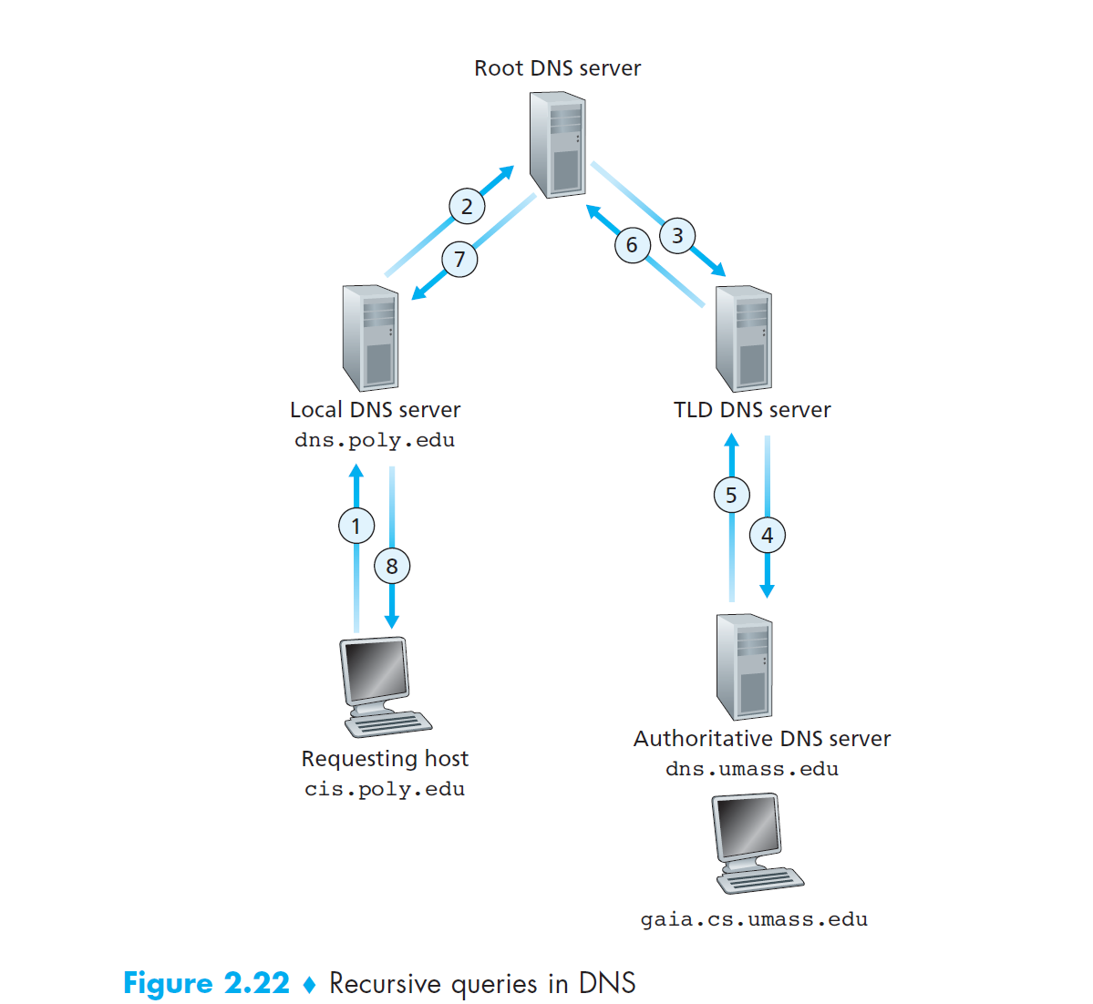

Slide 23
DNS Message Format
A resource record is a four-tuple that contains the following fields:
(Name, Value, Type, TTL)
DNS supports different types of records. Some of these record types are:
o A - An end device IPv4 address
o NS - An authoritative name server
o AAAA - An end device IPv6 address (pronounced quad-A)
o MX - A mail exchange record
DNS servers will first look at its own records to resolve the name. If the server is unable to resolve the name using its locally stored records, it relays the query to other servers.
The response is then forwarded to the requesting client.
The DNS Client service on Windows PCs also stores previously resolved names in memory.
Notes:
If a DNS server is authoritative for a particular hostname, then the DNS server will
contain a Type A record for the hostname. (Even if the DNS server is not authoritative,
it may contain a Type A record in its cache.) If a server is not authoritative for a hostname,
then the server will contain a Type NS record for the domain that includes the
hostname; it will also contain a Type A record that provides the IP address of the DNS
server in the Value field of the NS record. As an example, suppose an edu TLD server
is not authoritative for the host gaia.cs.umass.edu. Then this server will contain
a record for a domain that includes the host gaia.cs.umass.edu, for example,
(umass.edu, dns.umass.edu, NS). The edu TLD server would also contain
a Type Arecord, which maps the DNS server dns.umass.edu to an IP address, for
example, (dns.umass.edu, 128.119.40.111, A).

Slide 24
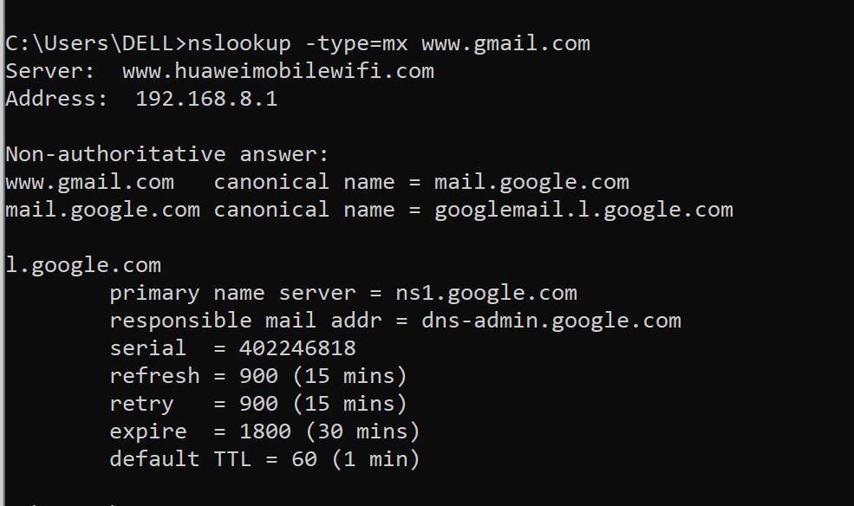

Slide 25
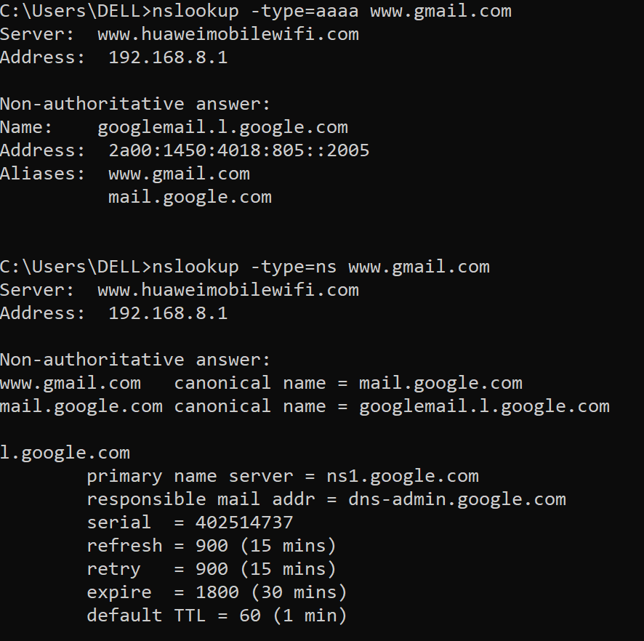

Slide 26
More on DNS
DNS Cache
Major attacks:
DNS Hijacking
Cache Poisoning/ DNS Spoofing
DNS DOS attack
DNS SEC
ipconfig /displaydns displays all of the cached DNS entries on Windows.
Nslookup command on cmd
Notes:
ipconfig /flushdns
Authoritative answer – This is the answer that originates from the DNS Server which has the information about the zone file. Non-authoritative answer – When a nameserver is not in the list for the domain you did a lookup on. Different port – By default, the DNS servers use port 53.

Slide 27
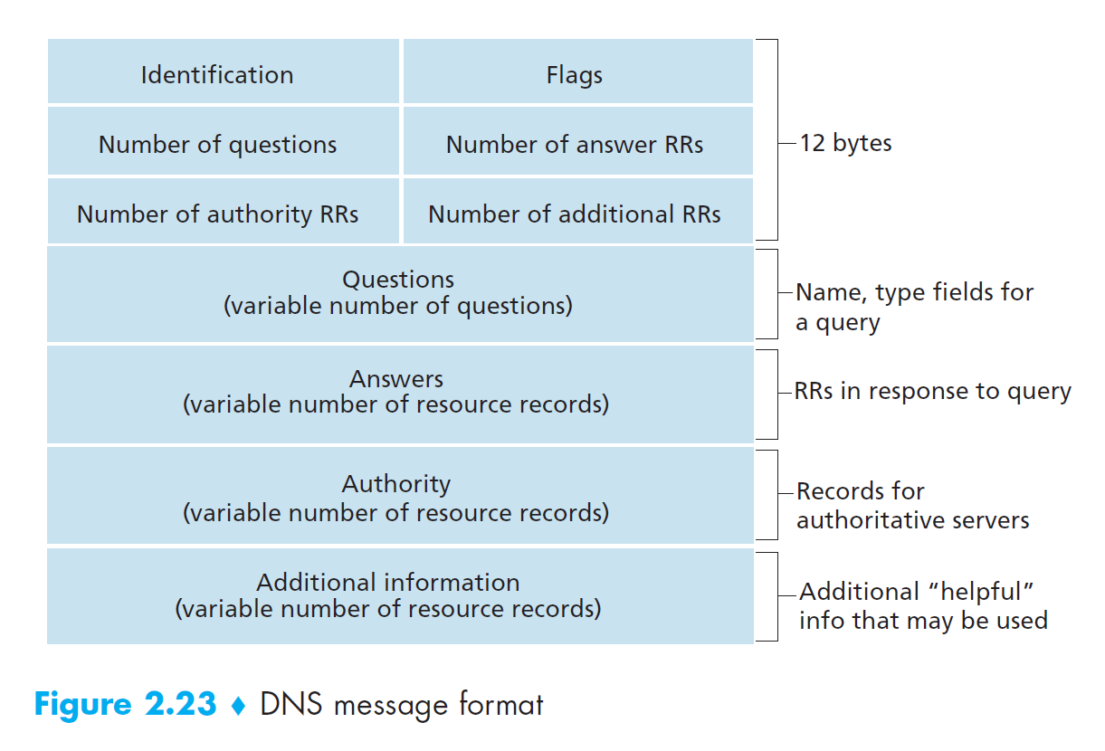
Home Assignment

